Slide 1

DEVELOPMENT AND IMPLEMENTATION OF AN ORGANIC GINIKAN PAPER MAKER MACHINE
Presented by:
Domingo, Kristelle Joy S.
Gabilan, Yves C.
Yambao, Angel Maebe C.

Slide 2
Overview
• Ginikan as an alternative paper pulp for paper manufacture
• Durable organic paper bag in the market
• The Advocacy of the agricultural community in Nueva ecija

Slide 3
Statement of the Problem
What is the socio-demographic profile of the Market’s customers?
Gender
Age (years)
Eco-friendly products advocate
Familiarity of Ginikan
What are the stages undertaken in the Development of an Organic Ginikan paper maker machine?
How will the development of the project affect the life of the community?

Slide 4
What is the assessment of the market’s customers, farmers and the community to the Development of an Organic paper maker machine in terms of:
Usability
Durability
Functionality
Efficiency
What are the problems encountered in using the paper maker machine that fabricates an Organic Ginikan paper?
What are the factors that contribute the effectiveness of developing of the proposal “Development and Implementation of an Organic Ginikan Paper Maker Machine”?

Slide 5
Research Paradigm
Theoretical Framework
Steam Theory
Darcy’s Law

Slide 6
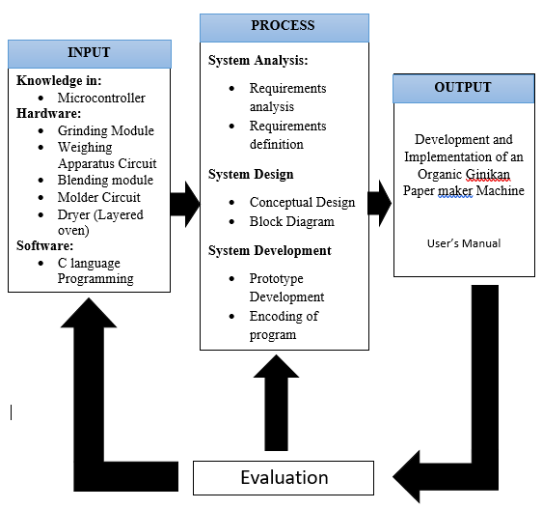
Conceptual Framework

Slide 7
Scope and Limitation
SCOPE | LIMITATION & DELIMITATION
Production an organic paper - durability Microprocessor for monitoring: - Weighing System Small – scale Production only | Not for mass Production The number of paper produced will be depending on the amount of Ginikan being processed in the machine. The paper cannot withstand with grease or any watery substance Not available for other components unless Ginikan (Haystack)

Slide 8
Significance of the Study
For the Community | For the Beneficiary | For Future researches
It can help contributing a non-biodegradable and organic product to the environment by opting to Ginikan paper. | For the Market, the study will help in their advocacy of using eco-friendly and organic materials. As well as for the Customers, it will provide them a sturdy paper wrapper as well as an awareness of using organic paper. For the Farmer’s Wife, this study can provide an additional income aside from the production of rice. | To discover another method of producing a cheap and organic Ginikan paper To research a way in lessening the cost of production

Slide 9
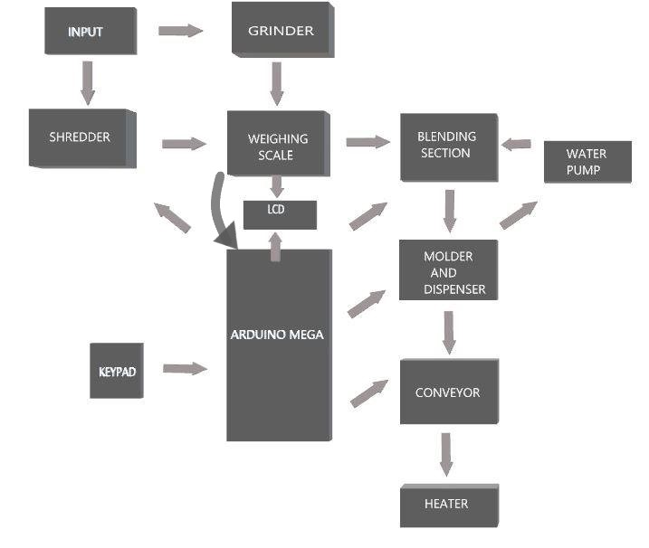
Block Diagram

Slide 10
System Process

Slide 11
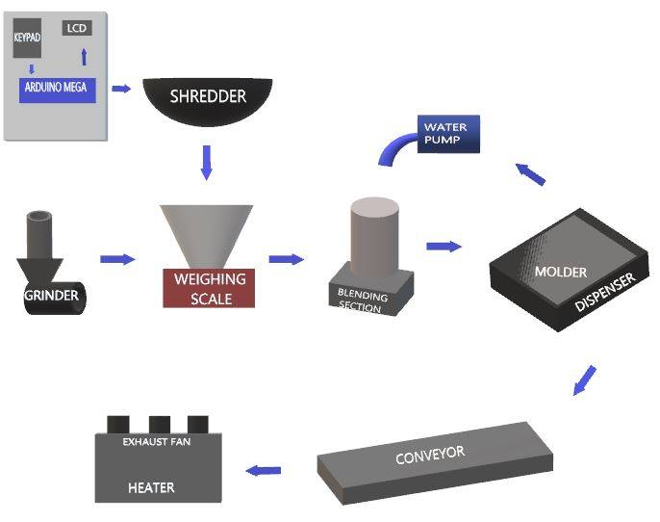

Slide 12
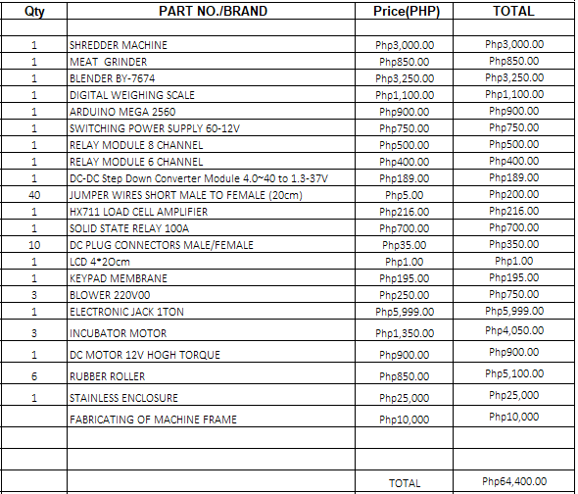
Costing

Slide 13
Questions | 5 | 4 | 3 | 2 | 1 | Mean
 | Strongly Agree | Agree | Neutral | Disagree | Strongly Disagree
Do you agree in using organic paper bags in lieu of plastic bags for purchased items in the market? | 38% | 0%
Bringing your own paper bag when going to the market.
Switching to biodegradable and reusable paper bag.
Scale: 5 is the highest and 1 is the lowest
Will you rate the quality of the recent paper wrapper or paper bag used in your items?
Durability
Usability
Duration of use

Slide 15
DEVELOPMENT AND IMPLEMENTATION OF AN ORGANIC GINIKAN PAPER MAKER MACHINE
End of Presentation
THANK YOU!

